Slide 1
Welcome to our project

Slide 2
The Team
Ahmed Ashraf Mohamed _ 202000563
Mohamed Hany Ramadan _ 202000165
Nouran Hady Shaaban _ 202001903
Marwa Mohamed Alsayed _ 202001356
Abd El_Rahman Yasser Ghonaim 202001502

Slide 3
Description
We have created a program that allows the user to add and delete medicines from the stock .Also, it allows him to update in the medicine details and he can see the medicines stored.

Slide 4
Flow chart
start
Input choice
yes
Add medicine
Choice==1
No
yes
Delete medicine
Choice==2
No
yes
Update medicine
Choice==3
No
yes
Print all medicines
Choice==4
No
yes
Choice==5
Print info of medicine
No
yes
Choice==6
Sell medicine
yes
Choice==7
quit
No
default
end

Slide 5
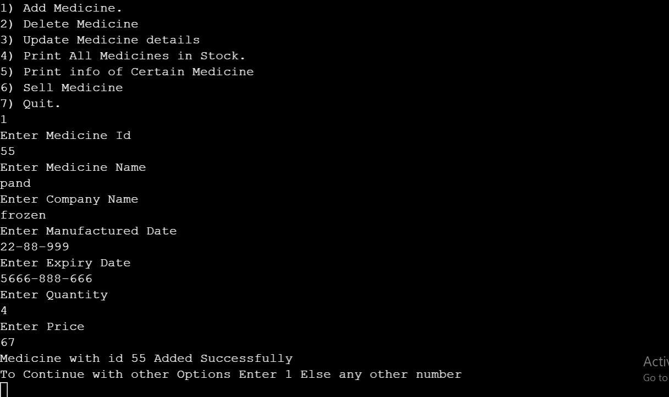
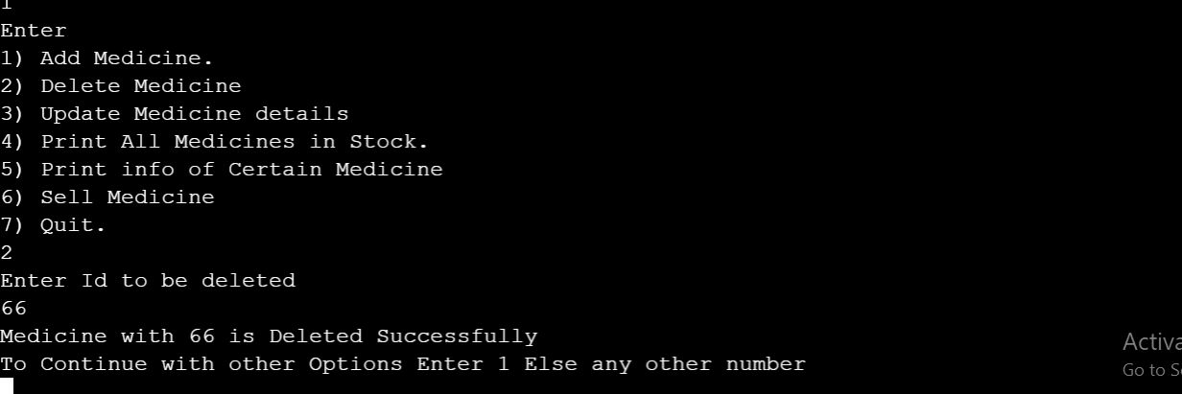
Add function
delete function

Slide 6
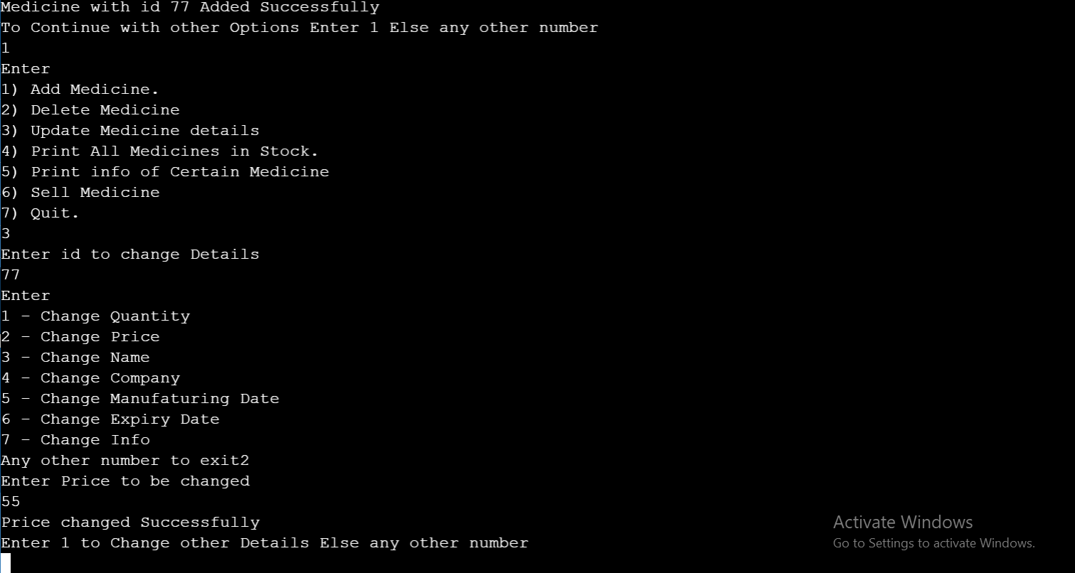
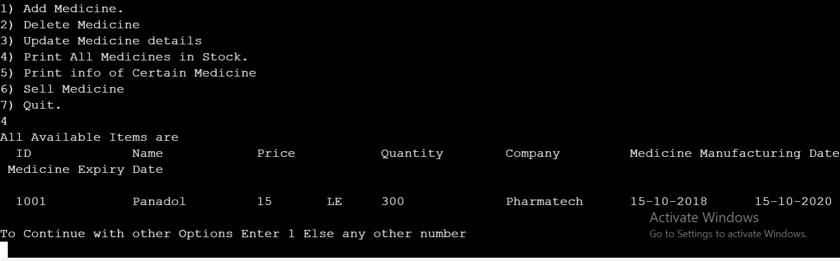
update function
Print all function

Slide 7
update function
Print all function

Slide 8
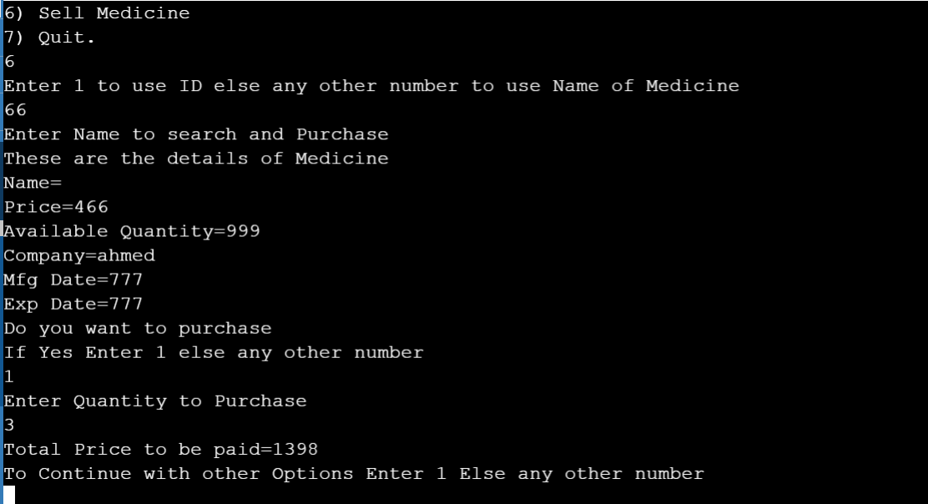
sell function

Slide 9
Thanks For Watching

